Slide 1
Spring Batch
An Introduction
Duncan McIntyre
Tanzu Solutions Engineer at VMware
June 2020

Slide 2
What Is Batch Processing?
Why Modernize
Why Do We Need A Framework?
What Is Spring Batch?
Spring Task – A Lightweight Alternative
When To Use Batch
Events Dear Boy, Events
Scaling
Writing A Spring Batch Job

Slide 3
What Is Batch Processing?
The Lifecycle Of A Batch Job

Slide 4
Batch vs Non-Batch
Lifecycle, State
Automated processing of large volumes of data without user interaction. Typically time-based - such as month-end calculations, notices, or correspondence.
Periodic application of complex business rules processed repetitively across very large data sets (for example, insurance benefit determination or rate adjustments).
Integration of information from internal and external systems requiring formatting, validation, and processing in a transactional manner into the system of record. Used to process billions of transactions every day for enterprises.
Traditional applications which run for an extended period (for ever if possible!) interacting either with end-users or with other systems.
May be stateless, or may have complex state which is not easily captured.
If the application dies, there may be no concept of “picking up where it left off”.
Batch Processing
Non-Batch Processing

Slide 5



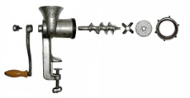


Lifecycle Of A Batch Job - Example
Not To Scale

Slide 6
Why Modernize?
Our existing batch works fine

Slide 7
Reasons To Modernize A Batch Application
And Reasons To Leave It Alone
Job is written in a legacy language which nobody uses any more
Job can’t be scaled any further
Batch is no longer appropriate – customers expect updates in real-time (Events!)
Cost savings
Easier and faster to develop and test in a cloud environment**
Cloud-based architecture could be deployed to multiple infrastructures**
Job works fine and meets all NFRs
Job needs to be close to the data/mainframe for performance reasons
Can’t take advantage of the cloud because of data gravity
Modernize!
Leave It Alone!

Slide 8

**

Slide 9
Why Do We Need A Framework?
Standards Are Good
Bad Things Happen
Knowledge Is Power

Slide 10
Why Do We Need A Framework?
Standards And Consistency Are Good
Duncan (it ain’t broke)
Reshmi (look, a GUI!)
Lisa (too cool for school)
Cron
Bash
Perl
COBOL
Python
Autosys
PyTK
Golang
Lambda
AI

Slide 11
Why Do We Need A Framework?
Just Use Duncan’s Code ☺
Jobs break
Jobs run slowly
How far did the job get?
Can the job be restarted?
Do broken jobs cleanup after themselves?
Can we scale up bits of the job to make it go faster?
Bad Things Happen
Knowledge Is Power

Slide 12
Spring Batch

Slide 13
Why Use Spring Batch?
If It Didn’t Exist, You’d Have To Invent It
Spring Batch developed by SpringSource (VMware) and Accenture to capture and codify decades of shared experience writing and running batch jobs in multiple languages and for multiple systems.
Spring Batch (2008) was the inspiration for JBatch - JSR-352 (2014), and is a conformant implementation.
Fully integrated with the rest of the Spring ecosystem
consume Spring Integration components
deploy using Spring Cloud Data Flow
wrap multiple jobs using Spring Cloud Task
Battle tested

Slide 14
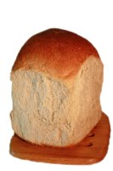
What Is Spring Batch?
A framework built on Spring for writing batch processing applications in Java
A set of architectural patterns which provide a standard way to implement desirable features such as observability, restartability and scalability
A scheduler
It Is
It Is Not
Image: http://www.cullysbakery.com/breads

Slide 15
(Some) Spring Batch Components
Job, Step, Reader, Processor, Writer
A Job is simply a container for Step instances. It combines multiple steps that belong logically together in a flow and allows for configuration of properties global to all steps, such as restartability
The job configuration contains:
The simple name of the job.
Definition and ordering of Step instances
Whether or not the job is restartable
Job
Step
Step
Step
Step
Step
ItemReader
ItemProcessor
ItemWriter
https://docs.spring.io/spring-batch/docs/current/reference/html/domain.html#job

Slide 16
Spring Task – A Lighter Alternative To Spring Batch

Slide 17

Spring Cloud Task
Image: https://www.heraldscotland.com/life_style/13084760.simply-special-ode-to-the-humble-oatcake/
Keeping Track Of Tasks
Field | Description
executionid | The unique ID for the task’s run.
exitCode | The exit code generated from an ExitCodeExceptionMapper implementation. If there is no exit code generated but an ApplicationFailedEvent is thrown, 1 is set. Otherwise, it is assumed to be 0.
taskName | The name for the task, as determined by the configured TaskNameResolver.
startTime | The time the task was started, as indicated by the SmartLifecycle#start call.
endTime | The time the task was completed, as indicated by the ApplicationReadyEvent.
exitMessage | Any information available at the time of exit. This can programmatically be set by a TaskExecutionListener.
errorMessage | If an exception is the cause of the end of the task (as indicated by an ApplicationFailedEvent), the stack trace for that exception is stored here.
arguments | A List of the string command line arguments as they were passed into the executable boot application.
Spring Cloud Task
Wraps a Spring Boot Application
Records the app’s executions and exit status
Spring Cloud Task
My Old App

Slide 18
When To Use Spring Batch, And How To Start

Slide 19
Task v. Batch
Which One To Use
Keep track of Step execution so a job can be be stopped and restarted
Implement interfaces to allow horizontal scaling
Listen for events in the lifecycle of a Job and react appropriately
Existing code works fine, just need a consistent way of keeping track of executions
Batch
Task

Slide 20
Getting Started With Batch
Basic Data Transformation Using Existing ItemReader and ItemWriter
Here’s one I prepared earlier ->
Item Reader | Description
AbstractItemCountingItemStreamItemReader | Abstract base class that provides basic restart capabilities by counting the number of items returned from an ItemReader.
AggregateItemReader | An ItemReader that delivers a list as its item, storing up objects from the injected ItemReader until they are ready to be packed out as a collection. This class must be used as a wrapper for a custom ItemReader that can identify the record boundaries. The custom reader should mark the beginning and end of records by returning an AggregateItem which responds true to its query methods isHeader() and isFooter(). Note that this reader is not part of the library of readers provided by Spring Batch but given as a sample in spring-batch-samples.
AmqpItemReader | Given a Spring AmqpTemplate, it provides synchronous receive methods. The receiveAndConvert() method lets you receive POJO objects.
KafkaItemReader | An ItemReader that reads messages from an Apache Kafka topic. It can be configured to read messages from multiple partitions of the same topic. This reader stores message offsets in the execution context to support restart capabilities.
FlatFileItemReader | Reads from a flat file. Includes ItemStream and Skippable functionality. See FlatFileItemReader.
HibernateCursorItemReader | Reads from a cursor based on an HQL query. See Cursor-based ItemReaders.
HibernatePagingItemReader | Reads from a paginated HQL query
ItemReaderAdapter | Adapts any class to the ItemReader interface.
JdbcCursorItemReader | Reads from a database cursor via JDBC. See Cursor-based ItemReaders.
JdbcPagingItemReader | Given an SQL statement, pages through the rows, such that large datasets can be read without running out of memory.
JmsItemReader | Given a Spring JmsOperations object and a JMS Destination or destination name to which to send errors, provides items received through the injected JmsOperations#receive() method.
JpaPagingItemReader | Given a JPQL statement, pages through the rows, such that large datasets can be read without running out of memory.
ListItemReader | Provides the items from a list, one at a time.
MongoItemReader | Given a MongoOperations object and a JSON-based MongoDB query, provides items received from the MongoOperations#find() method.
Neo4jItemReader | Given a Neo4jOperations object and the components of a Cyhper query, items are returned as the result of the Neo4jOperations.query method.
RepositoryItemReader | Given a Spring Data PagingAndSortingRepository object, a Sort, and the name of method to execute, returns items provided by the Spring Data repository implementation.
StoredProcedureItemReader | Reads from a database cursor resulting from the execution of a database stored procedure. See StoredProcedureItemReader
StaxEventItemReader | Reads via StAX. see StaxEventItemReader.
JsonItemReader | Reads items from a Json document. see JsonItemReader.
Item Writer | Description
AbstractItemStreamItemWriter | Abstract base class that combines the ItemStream and ItemWriter interfaces.
AmqpItemWriter | Given a Spring AmqpTemplate, it provides for a synchronous send method. The convertAndSend(Object) method lets you send POJO objects.
CompositeItemWriter | Passes an item to the write method of each in an injected List of ItemWriter objects.
FlatFileItemWriter | Writes to a flat file. Includes ItemStream and Skippable functionality. See FlatFileItemWriter.
GemfireItemWriter | Using a GemfireOperations object, items are either written or removed from the Gemfire instance based on the configuration of the delete flag.
HibernateItemWriter | This item writer is Hibernate-session aware and handles some transaction-related work that a non-"hibernate-aware" item writer would not need to know about and then delegates to another item writer to do the actual writing.
ItemWriterAdapter | Adapts any class to the ItemWriter interface.
JdbcBatchItemWriter | Uses batching features from a PreparedStatement, if available, and can take rudimentary steps to locate a failure during a flush.
JmsItemWriter | Using a JmsOperations object, items are written to the default queue through the JmsOperations#convertAndSend() method.
JpaItemWriter | This item writer is JPA EntityManager-aware and handles some transaction-related work that a non-"JPA-aware" ItemWriter would not need to know about and then delegates to another writer to do the actual writing.
KafkaItemWriter | Using a KafkaTemplate object, items are written to the default topic through the KafkaTemplate#sendDefault(Object, Object) method using a Converter to map the key from the item. A delete flag can also be configured to send delete events to the topic.
MimeMessageItemWriter | Using Spring’s JavaMailSender, items of type MimeMessage are sent as mail messages.
MongoItemWriter | Given a MongoOperations object, items are written through the MongoOperations.save(Object) method. The actual write is delayed until the last possible moment before the transaction commits.
Neo4jItemWriter | Given a Neo4jOperations object, items are persisted through the save(Object) method or deleted through the delete(Object) per the ItemWriter’s configuration
PropertyExtractingDelegatingItemWriter | Extends AbstractMethodInvokingDelegator creating arguments on the fly. Arguments are created by retrieving the values from the fields in the item to be processed (through a SpringBeanWrapper), based on an injected array of field names.
RepositoryItemWriter | Given a Spring Data CrudRepository implementation, items are saved through the method specified in the configuration.
StaxEventItemWriter | Uses a Marshaller implementation to convert each item to XML and then writes it to an XML file using StAX.
JsonFileItemWriter | Uses a JsonObjectMarshaller implementation to convert each item to Json and then writes it to an Json file.
that’s enough food-based jokes - Ed

Slide 21
Isn’t Everything Event-Driven These Days?
Why bother with batch at all?

Slide 22


Batch vs Events
Why Use One Or The Other?
Pros
Only uses resources intermittently
Can maximize usage of a running resource (scale out after scale-up)
Easy to understand and test
Deterministic (?)
Cons
Needs scheduling
Scaling needs to be explicitly coded for
Pros
No scheduling requirement
Handles scale by design
Cons
Uses resources constantly, maybe inefficiently (functions mitigate this)
Existing systems may not be event sources
Batch
Events

Slide 23
Scaling Up

Slide 24
Parallel Processing Strategies
Local and Remote
Multi-Threaded
Step
Parallel
Steps
Remote Chunking
Of Step
Partitioning
A Step
Run any individual Step in multiple threads on one host
Run two or more Steps in parallel on one host
Manager Step slices the input data into Chunks and posts them to middleware (message queue).
Worker Steps take chunks from the queue for processing.
Like Remote Chunking, but the Manager Step knows how to talk to the compute fabric to directly schedule remote Step execution

Slide 25
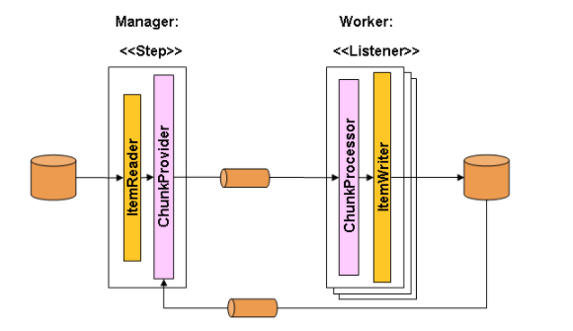
Remote Chunking
Sharing The Load With Messaging
Middleware must guarantee to not lose messages

Slide 26
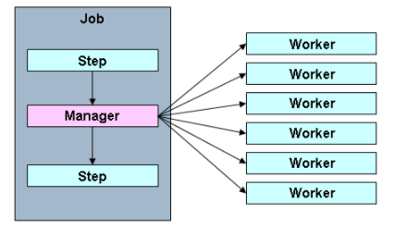
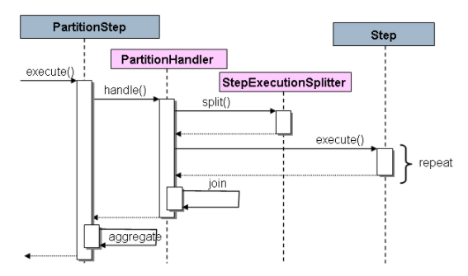
Partitioning
Cloud Native Processing
PartitionHandler knows how to get a remote Step scheduled and executed on a fabric.
- Cloud Foundry
- Kubernetes
- RMI
- EJB
- …

Slide 27
Let’s Write A Job
https://spring.io/guides/gs/batch-processing/

Slide 28
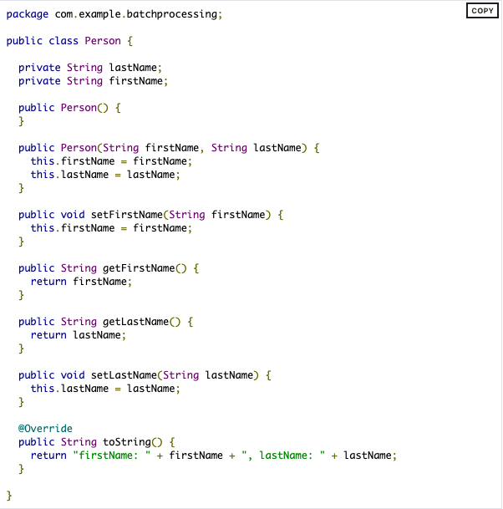
Create A Business Class
A Simple POJO
We’ll write a batch job to transform people’s names

Slide 29
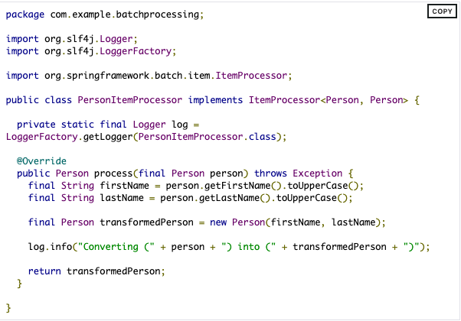
The Business Logic
Writing An ItemProcessor
public interface ItemProcessor<I, O> {
O process(I item) throws Exception;
}
Job
Step
Step
Step
Step
Step
ItemReader
ItemProcessor
ItemWriter

Slide 30
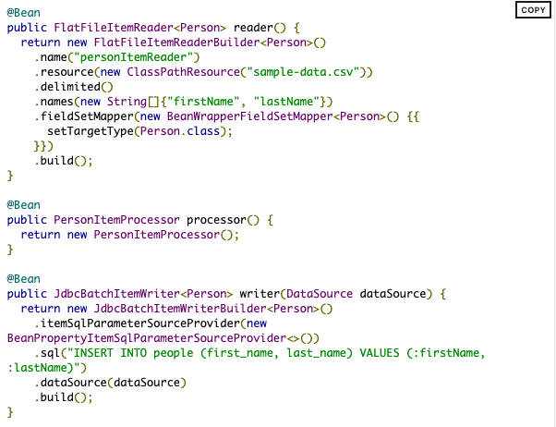
ItemReader and ItemWriter
Moving The Data
public interface ItemReader<T> {
T read() throws Exception…;
}
public interface ItemWriter<T> {
void write(List<? extends T> items) throws Exception…;
}
Job
Step
Step
Step
Step
Step
ItemReader
ItemProcessor
ItemWriter

Slide 31
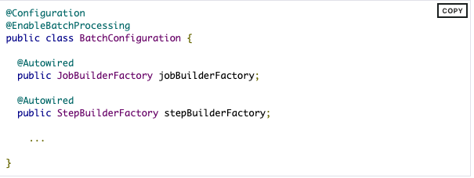
Wiring Things Up
Enabling Jobs Using Annotations
Annotations enable a set of supporting beans, including an in-memory job respository

Slide 32
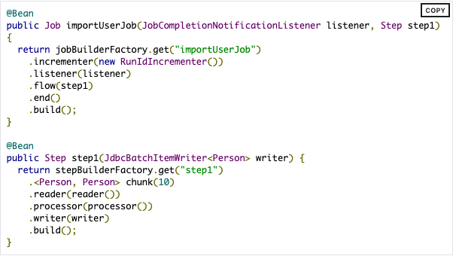
Wiring Things Up
Defining The Job and Step Using Builders
Builders are used to declare the sequence of Steps in a Job and other configuration.
Builders can also be used to define a Step.
Job
Step
Step
Step
Step
Step
ItemReader
ItemProcessor
ItemWriter

Slide 33
Recap
Job, Step, Reader, Processor, Writer
Jobs have several additional properties which can be used to control their behavior.
- Restartability
- Before and After Job/Step execution
- Id generation strategy
- Exit code mapping
- Line aggregation
- Writing headers and footers
- …
Job: “importUserJob”
Step: “step1”
FlatFileItemReader
PersonItemProcessor
JdbcBatchItemWriter
RunIdIncrementer
JobCompletion NotificationListener

Slide 34
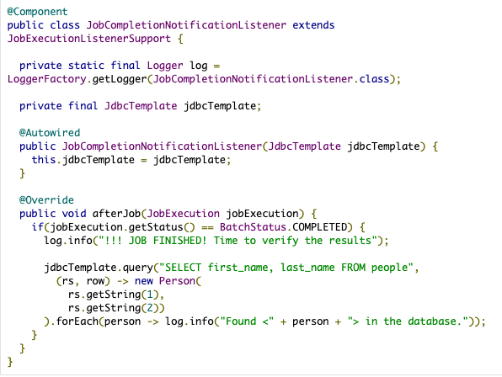
Wiring Things Up
Execution Listener
Prints out the results of running the Job once the Job has completed

Slide 35
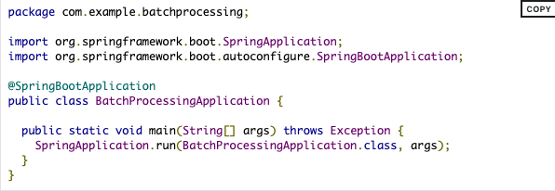
Wiring Things Up
The Application
Create a runnable JAR file

Slide 36
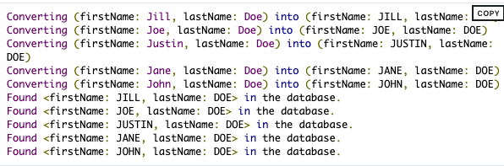
Results of Running The Job
Not Just Another Hello World!

Slide 37
More Terminology
Spring Batch Application
Job
JobParameters
Scheduler
Step
JobRunner
JobExecution
Data
ItemReader
StepExecution
ItemProcessor
Any scheduler
Starts the Batch application.
JobRunner locates and starts the job.
ItemWriter
JobLocator
JobLauncher
Job
Job
JobRepository
JobRepository implementation is responsible for storing and retrieving the state of a job execution.
JobExecution: history of when a Job was run
StepExecution: history of Steps in a Job

Slide 38
JobExecution Properties
Property | Definition
Status | A BatchStatus object that indicates the status of the execution. While running, it is BatchStatus#STARTED. If it fails, it is BatchStatus#FAILED. If it finishes successfully, it is BatchStatus#COMPLETED
startTime | A java.util.Date representing the current system time when the execution was started. This field is empty if the job has yet to start.
endTime | A java.util.Date representing the current system time when the execution finished, regardless of whether or not it was successful. The field is empty if the job has yet to finish.
exitStatus | The ExitStatus, indicating the result of the run. It is most important, because it contains an exit code that is returned to the caller. See chapter 5 for more details. The field is empty if the job has yet to finish.
createTime | A java.util.Date representing the current system time when the JobExecution was first persisted. The job may not have been started yet (and thus has no start time), but it always has a createTime, which is required by the framework for managing job level ExecutionContexts.
lastUpdated | A java.util.Date representing the last time a JobExecution was persisted. This field is empty if the job has yet to start.
executionContext | The "property bag" containing any user data that needs to be persisted between executions.
failureExceptions | The list of exceptions encountered during the execution of a Job. These can be useful if more than one exception is encountered during the failure of a Job.

Slide 39
StepExecution Properties
Property | Definition
Status | A BatchStatus object that indicates the status of the execution. While running, the status is BatchStatus.STARTED. If it fails, the status is BatchStatus.FAILED. If it finishes successfully, the status is BatchStatus.COMPLETED.
startTime | A java.util.Date representing the current system time when the execution was started. This field is empty if the step has yet to start.
endTime | A java.util.Date representing the current system time when the execution finished, regardless of whether or not it was successful. This field is empty if the step has yet to exit.
exitStatus | The ExitStatus indicating the result of the execution. It is most important, because it contains an exit code that is returned to the caller. See chapter 5 for more details. This field is empty if the job has yet to exit.
executionContext | The "property bag" containing any user data that needs to be persisted between executions.
readCount | The number of items that have been successfully read.
writeCount | The number of items that have been successfully written.
commitCount | The number of transactions that have been committed for this execution.
rollbackCount | The number of times the business transaction controlled by the Step has been rolled back.
readSkipCount | The number of times read has failed, resulting in a skipped item.
processSkipCount | The number of times process has failed, resulting in a skipped item.
filterCount | The number of items that have been 'filtered' by the ItemProcessor.
writeSkipCount | The number of times write has failed, resulting in a skipped item.

Slide 40
Questions?

